Slide 1



ウェビナーを起点とした “本気 ”のBtoBマーケティング支 援 「マジセミ」のご紹介
For those considering Majisemi for the first time
集客に強いセミナー
No.1
Seminars strong in acquiring new business negotiations
No.1
Seminars chosen by IT managers
No.1
Survey by Japan Marketing Research Organization Overview: 2021 Service Comparison Impression Survey

Slide 2
Introduction
Purpose of today's meeting
For companies considering "Majisemi" for the first time, we will discuss the following topics.
Hearing about challenges in marketing
How will you utilize Majisemi?
©2018 MAJISEMI Inc.

Slide 3
Hearing
©2018 MAJISEMI Inc.

Slide 4
Hearing
Issue Identification
■ About the products to be introduced in the seminar
・Which products/services?
・Who is the target audience (who do you want to invite to the seminar)?
・Industry, company size, department, position, etc.
※ Majisemi's areas of expertise are "IT departments, DX departments, security departments across all industries, and production/manufacturing departments in factories"
・Who are the competitors?
・What are the strengths and differentiation points compared to competitor products?
©2018 MAJISEMI Inc.

Slide 5
Hearing
Issue Identification
■ About the necessity of seminars (webinars)
・What is considered important for lead acquisition?
・Seminar (webinar)
・Website (content marketing)
・Real exhibitions
・比較サイト
・GoogleやFacebookなどへの広告
・テレアポ
・その他
■予算の状況
・リード獲得単価、アポ獲得単価
・セミナー（ウェビナー）の予算の有無、及び金額
・上記リード獲得手段の予算の割合
・予算の策定、決定時期
©2018 MAJISEMI Inc.

Slide 6
Hearing
Issue Identification
■セミナー（ウェビナー）の目的／課題
・より多くのリードを獲得したい／集客できない
・ターゲットに合ったリードを獲得したい／リードの質が悪い
・ウェビナーから商談につなげたい／商談につながらない
・ウェビナーの運営を代行してほしい／運営が大変
・まずはスモールスタートでウェビナーをやってみたい
・その他
・ウェビナーを活用した、東南アジアにおける新規顧客開拓やテストマーケティング
©2018 MAJISEMI Inc.

Slide 7
なぜ「ウェビナー」なのか？
©2018 MAJISEMI Inc.

Slide 8
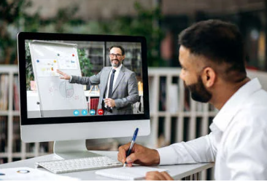

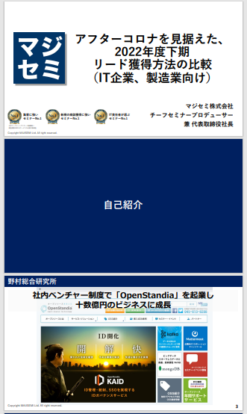
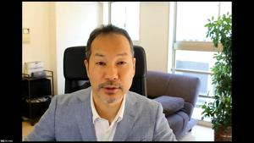
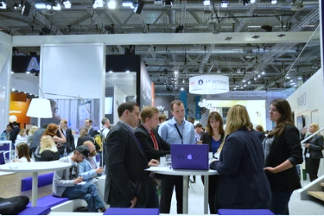
BtoBマーケティングにおけるウェビナーの役割
Webinar
as a Service
Lead acquisition
Lead Nurturing
Proposal and order
課題に
気づいてない
課題に気づき
社内で検討
製品・サービスの
候補を捜す
製品・サービスを絞って
評価・選定、稟議
課題に気づかせる
課題について深く理解させ、
解決方法を提示する
競合よりもお客様に早く接触し、課題解決をサポートする
数社～十数者程度の検討の候補に入り、２～３社の最終候補に残る
２～３社の最終候補から自社を選んでもらう
Utilization of Webinar Content
課題に気づかせる。
課題について深く理解させる。
競合よりもお客様に先に接触し、自社を知ってもらう。
When hosting a webinar,
a lot of content is generated.
● Presentation materials → White Paper
● Presentation video → YouTube, Social Media
● Presentation content → SEO articles, blogs
Webinar
Field Sales
Webサイト
Content Marketing
Webinar
Social Media Advertising
Deepen understanding of challenges.
Also provide competitive comparison information and information about our products.
For nurturing existing leads.
リアル展示会
オンラインイベント
Downloadable Materials
Field Sales
©2018 MAJISEMI Inc.

Slide 9

Email Advertising
Positioning of Webinars in Lead Acquisition
planning
Cost per Lead
Telemarketing
30,000 yen
Webinar
リアル展示会
Listing/Social Media Advertising
Visitor
14,500 yen
Majisemi
Club
10,000 yen and up
10,000 yen
Online
Exhibition
(Large-scale Webinar)
Comparison Sites
Downloadable Materials
オンデマンド
Video distribution
5,000 yen
リアル展示会
Joint exhibition
Low
Interest
High
©2018 MAJISEMI Inc.

Slide 10
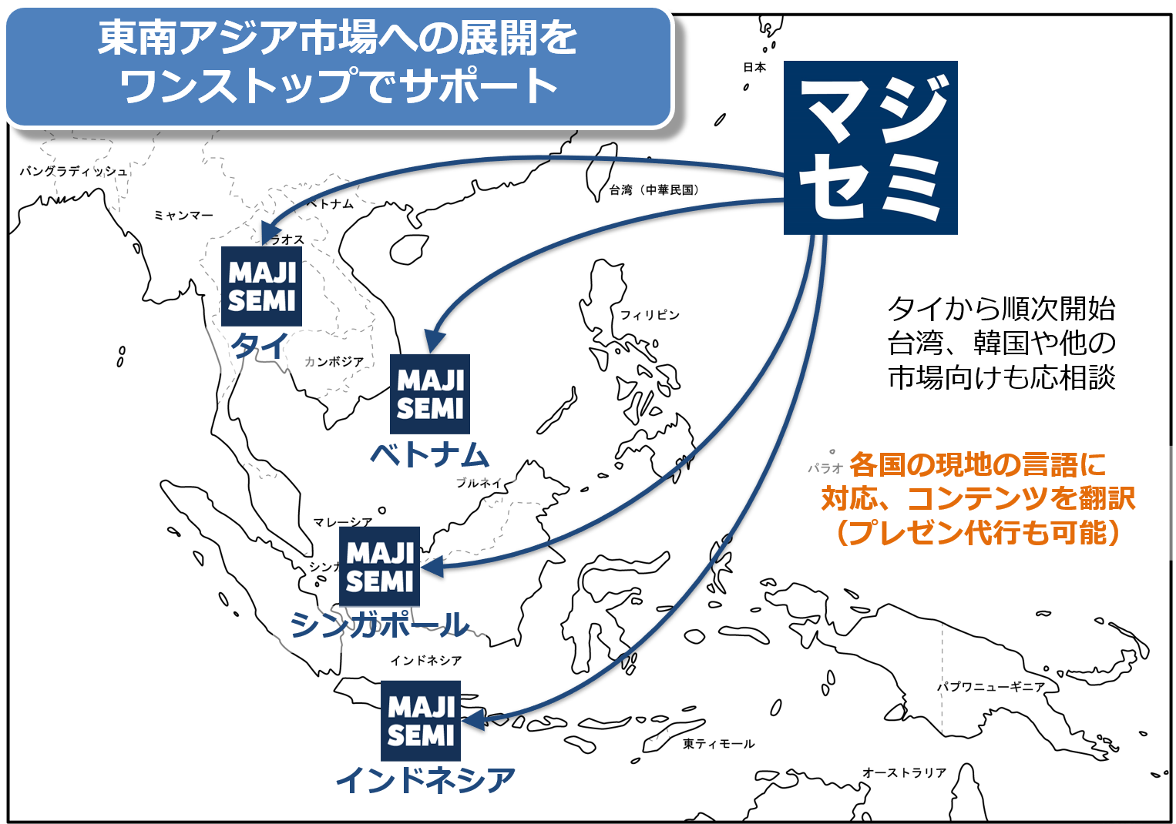
ウェビナーを活用した東南アジア進出支援
planning
日本国内向けとほぼ同じ価格で、東南アジア向けにウェビナー配信が可能。
貴社は日本語（又は英語）でのプレゼン動画（＋スライド）を用意するだけ。
現地語での字幕の追加、スライドの翻訳、当日の配信まで、全てマジセミ側で対応。
オプションで、ウェビナー後のリードフォローや、現地語対応済みのウェビナー動画の２次利用なども可能。
東南アジアで開催される展示会への共同出展も推進中。
©2018 MAJISEMI Inc.

Slide 11


なぜ“ウェビナー起点”なのか？
planning
何も接点がないところから、いきなりのテレアポやDMは不信感につながります。
まずは「価値がある情報を提供」するウェビナーを開催することで、最初の接点を構築すると共に、
「信用・信頼」を獲得することができます。
ウェビナーの特徴
When emailing the entire list
「インタラクティブな体験」を提供できる
ライブでの質疑応答
質問や要望を受けながらのデモ、工場視察
「生のフィードバック」を得られる
事前/事後アンケートはもちろん、講演中の投票や質問など
「興味関心が高い」視聴者を得られる
少人数ウェビナーの場合、貴社の商品・サービスが解決できる課題について、困っている人が参加する
「場を共有する」ことで信頼関係を構築する
“先生”として認知
質疑応答などのコミュニケーションを通じた信頼関係の構築
0.7%
70%
メールで資料案内した場合の
is about 100 times!
When emailing seminar participants
お客様とFace to Faceの
コミュニケーションができ、 信用 ・信頼がアップ
その後のフォローに対する
反応が、約100倍違う
※ According to our research
©2018 MAJISEMI Inc.

Slide 12
マジセミのサービス概要
©2018 MAJISEMI Inc.

Slide 13
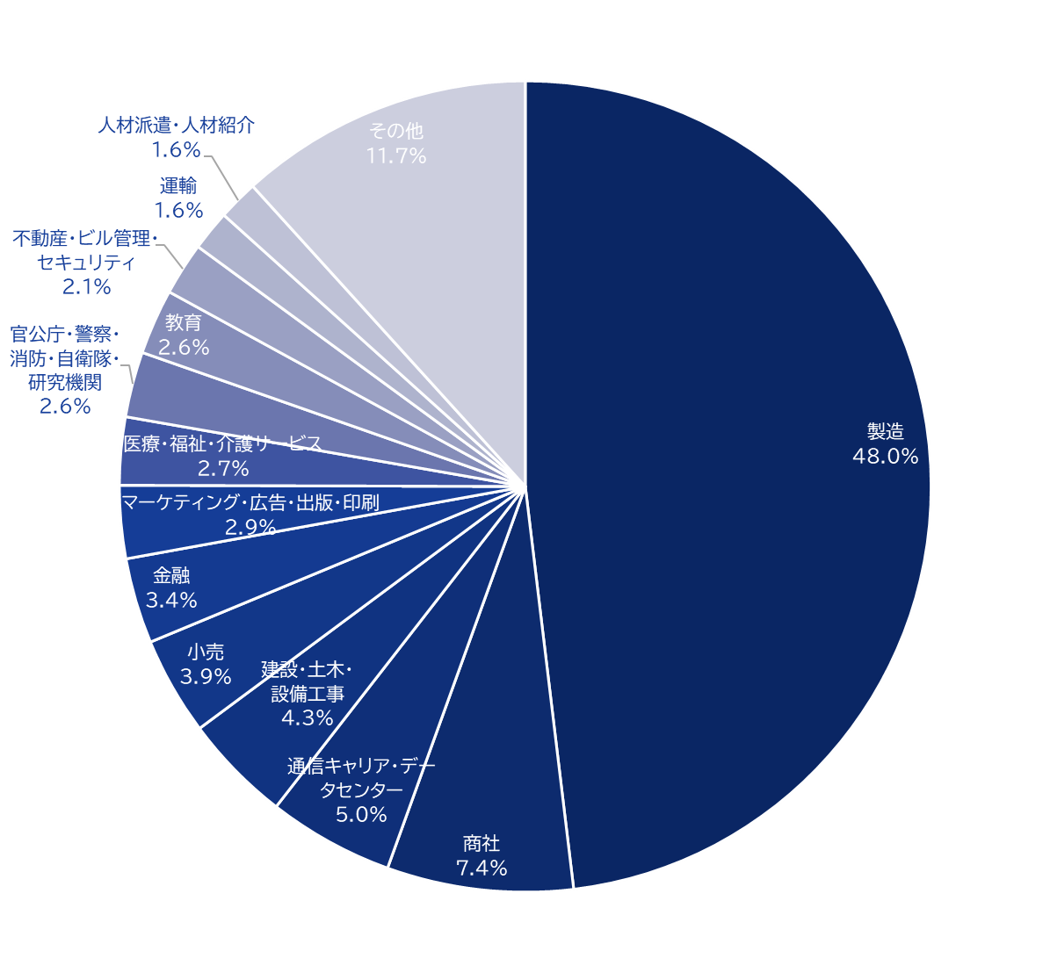
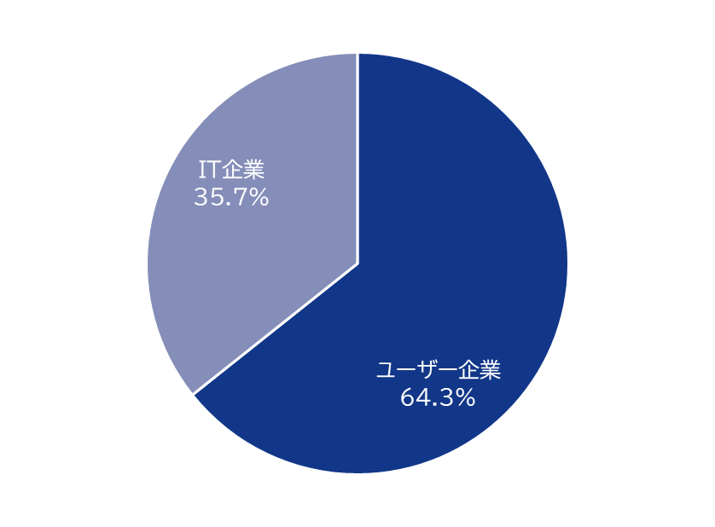
マジセミのハウスリスト
Webinar
as a Service
集客力
約25万件の
ハウスリストを所有！
ユーザー企業内訳
House
List
Overall
※2020～202４年開催のセミナー申込者から推測
©2018 MAJISEMI Inc.

Slide 14
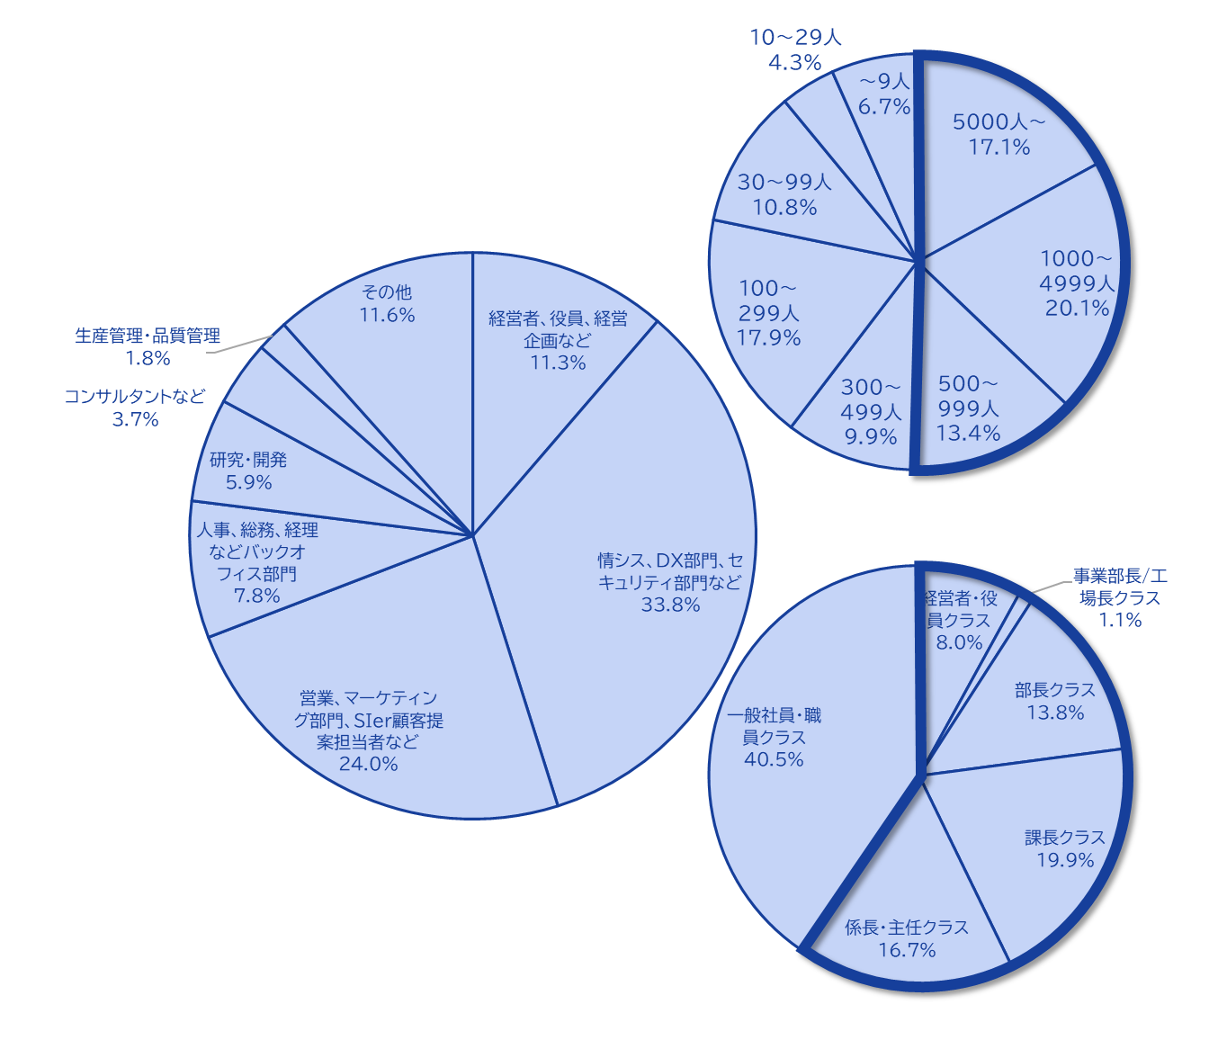
マジセミのハウスリスト
Webinar
as a Service
The Majisemi list is
is almost exclusively focused on the following attributes.
Nearly half work at
大企業にお勤め
Company
Size
All industries × Information systems departments, DX-related departments
All industries × Security departments
Manufacturing × Production and manufacturing departments
All industries × Back office departments
IT Companies × All Job Functions
Job function
ハウスリスト内訳
マジセミでは、より貴社の商品・サービスにマッチした方にウェビナーにご参加いただくために、メール等で集客をする際に、属性指定（セグメント）をする方式ではなく、
ウェビナーのテーマ設定（タイトル、告知文）を、
on behalf of Majisemi,
adopting a method that increases the proportion of your target audience.
Emails are not sent to all contacts, but prioritized for those highly interested in the set theme.
Position
Primarily managers
©2018 MAJISEMI Inc.

Slide 15





Why is it necessary to hold webinars?
Webinar
as a Service
The value of cold leads and the importance of repeating webinars
Lead acquisition
Nurturing and business negotiations
Contract
1 individual
Hot leads
3 participants
Seminar hosting
30 participants
Cold lead
21 individuals
Repeatedly held
It's important to do so!
27 individuals
By repeatedly holding webinars, including past participants,
to efficiently acquire new leads and nurture them.
If left unattended
21 individuals
80% sign contracts with
competitors within 2 years
Majisemi conducts long-term follow-ups with past participants,
and also offers 'Maji Follow Plus' to assist in appointment acquisition.
(SiriusDecisions survey)
©2018 MAJISEMI Inc.

Slide 16








Reasons to use Majisemi
Webinar
as a Service
Delegate your webinar operations to us
Repeat PDCA to explore winning patterns
Planning
Attracting attendees
Seminar
Secretariat
Moderation
Appointment acquisition
(Optional)
Survey aggregation
Report creation
SEO article creation
Video production
(Optional)
Review &
Improvement
With a one-stop service,
from start to finish
Majisemi handles it all, so
All support included
with only the cost of attracting attendees!
Focus on the presentation
on the day!
©2018 MAJISEMI Inc.

Slide 17

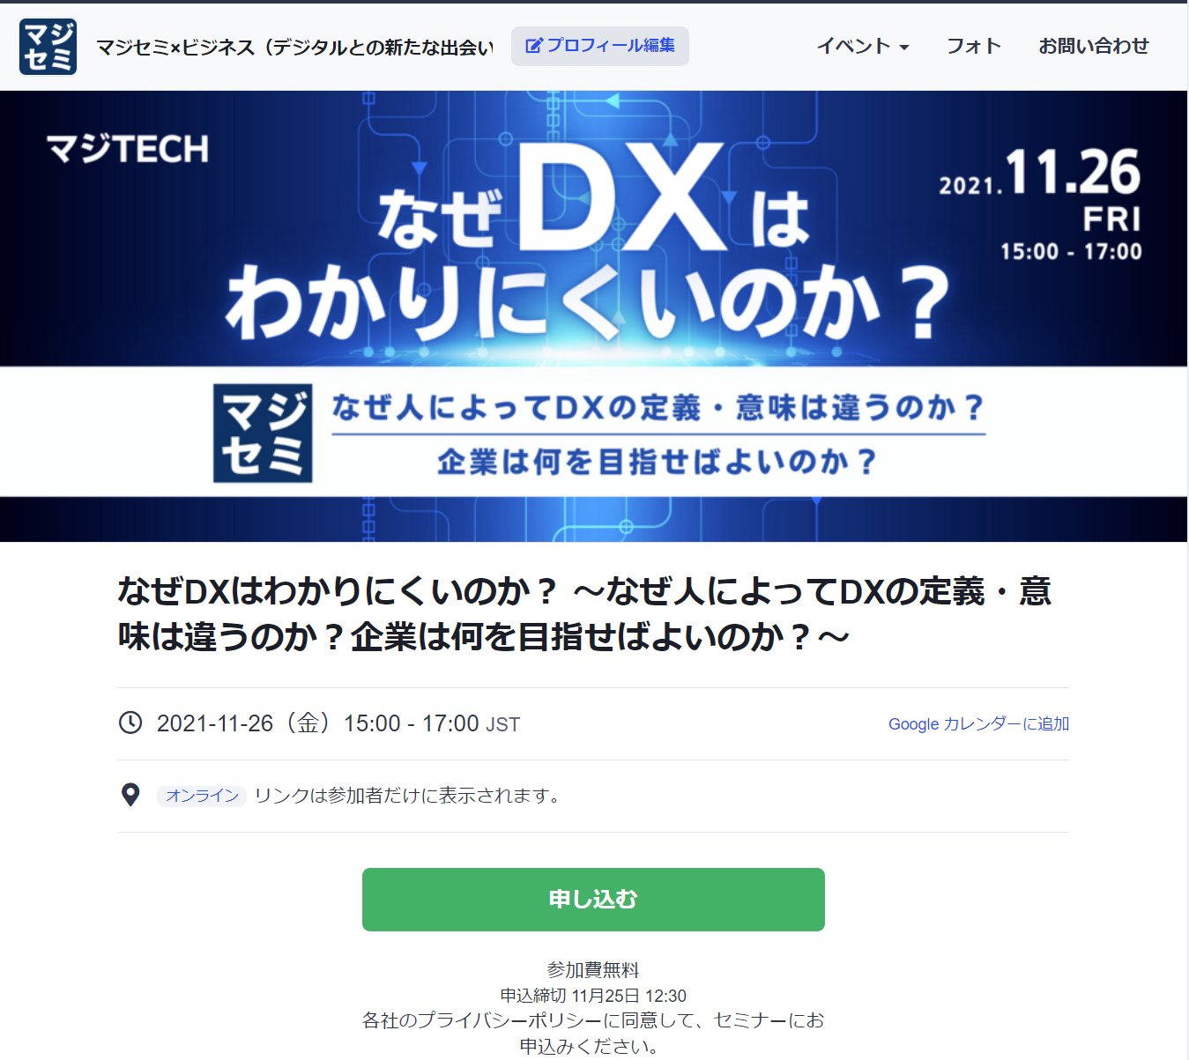
Reasons to use Majisemi
Webinar
as a Service
In a single webinar, it is possible to acquire new leads and nurture existing leads simultaneously
Audience acquisition page creation & publication
Attracting attendees
Majisemi management screen
Reminder distribution 1 week before & the day before
Majisemi audience acquisition slot
Attracting customers with Majisemi
Majisemi slot
Applicant data
Distribution of participation URL
Plan finalized
Applications to your customer acquisition slot
Applications are
not subject to charges, regardless of the number!
For nurturing your existing
house list nurturing,
reviving dormant customers,
and acquiring new leads through your website, etc.,
please make full use of this!
Your audience acquisition slot
After publication
We will provide
will be provided
Attract customers through your company's house list and website, etc.
Your audience acquisition slot
Applicant data
We will create a dedicated customer acquisition site URL for you
we will create a dedicated customer acquisition site URL for your company.
Delivery of all leads to your company
©2018 MAJISEMI Inc.
*Excludes disqualified applicants and those on the waiting list

Slide 18
Successful webinar case studies

Slide 19
(Case 1) "Changed the theme and achieved over 120 attendees" <Company C>
■ Customer's challenges
・サーバ／インフラ系サービスを中心に販売されている、SIer様
・We are hosting webinars in-house but are unable to attract an audience
・Even when outsourcing to media, we couldn't attract an audience
■ Plan utilized
・Visitor (later transitioned to Majisemi Club)
■ Response by Majisemi
・Using the know-how from hosting 1,000 webinars ann ually and tools like 'Trend Analysis Tool', Majis emi plans and proposes 'attractive event concepts'.
■ Results
・Achieved an audience of over 120 participants
©2018 MAJISEMI Inc.

Slide 20
(Case 2) "While exploring themes, achieved over 50% appointment acquisition" <Company T>
■ Customer's challenges
・Tool vendors
・Focused on marketing through exhibitions, but struggled to turn them into business opportunities
■ Plan utilized
・Visitor (later transitioned to Majisemi Club)
■ Response by Majisemi
・Repeatedly held webinars while searching for 'the mes that attract audiences and lead to business'.
■ Results
・Improved conversion rates from 10% to 20% to 50% while attracting about 30 participants each time
・Presenters themselves conduct follow-ups after the webinar
©2018 MAJISEMI Inc.

Slide 21
(Case Study 3) "Switched to online and acquired 20% appointments" <Company Z>
■ Customer's challenges
・Global IT company developing and selling packaged products and SaaS
・Holding offline seminars but struggling with attendance and participation rates
・Not leading to business discussions
■ Plan utilized
・Visitor
■ Response by Majisemi
・Proposal for online (webinars)
・Conducted 'seminar concepts that lead to business discussions'
■ Results
・Achieved 6 appointments from 30 sign-ups
©2018 MAJISEMI Inc.
‹#›

Slide 22
(Case Study 4) 'Acquired over 15% appointments with follow-up outsourcing' <Company I>
■ Customer's challenges
・Infrastructure IT venture company also developing in-house products
・Held multiple webinars with good attendance but not leading to business discussions
・Person in charge is too busy to sufficiently follow up on sales after webinars
■ Plan utilized
・Visitor
■ Response by Majisemi
・Conducted 'seminar concepts that lead to business discussions'
・Implemented 'Majifollow', a follow-up service that makes calls right after webinars
■ Results
・Achieved 8 appointments from 50 sign-ups
©2018 MAJISEMI Inc.

Slide 23
(Case Study 5) "AI presented and acquired 20% appointments" <Company A>
■ Customer's challenges
・Foreign-owned SaaS vendor
・Achieving audience targets every time, but not leading to business discussions
・Challenges with presentation materials and content
■ Plan utilized
・Majisemi Club
■ Response by Majisemi
・Implemented AI-generated speech scripts and AI digital human presentation delegation
・Implemented 'Majifollow', a follow-up service that makes calls right after webinars
■ Results
・Achieved 4 appointments from 20 sign-ups
©2018 MAJISEMI Inc.

Slide 24
About plans and pricing
©2018 MAJISEMI Inc.

Slide 25
Plan Comparison
Pricing Plans
Recommended
 | Visitor | Majisemi Club Light | Majisemi Club Business Negotiation Guarantee
Recommended for these individuals! | Planning to hold webinars 1 to 2 times a year | Planning to hold webinars 4 times or more annually Want to reduce cost per lead | Want business negotiations (appointments) rather than just attracting attendees Want a guarantee
Cost per lead comparison | 14,500 yen | 12,000 yen (10 people monthly) 10,000 yen (for additional audience) | 20,000 yen (30 people in 3 months) 13,500 yen (for additional audience)
Not subject to duplicate charges for past applicants ※Refer to the description for details on each plan | None | Available | Available
Business discussion (appointment) guarantee ※Refer to the description for details on each plan | None | None | Available
Contract period | Per session | Monthly (Auto-renewal) | Every 3 months (Auto-renewal)
©2018 MAJISEMI Inc.

Slide 26
Are there any services other than the basic plan that interest you?
Service Map
Limited slots
First-come, first-served
Exhibition
Joint exhibition
Your company-owned leads
(Not subject to charge)
Webinar hosting
Lead follow-up, proposal, and order
Recommended
New service
Presentation script/materials
Content creation agency
AI-powered presentation agency
Webinar hosting
(Visitor or Majisemi Club)
Follow-up immediatel y after the webinar
(Maji Follow)
Sales outsourcing
(Proposal and order)
(Maji Sales)
Your Company Inside Sales
or Fiel d Sales
Recommended
New service
Many companies
Will be utilized
Missed
Distribution
Rebroadcast
2-step
Webinar
Many companies
Will be utilized
Utilization of webinar content
Many companies
Will be utilized
Many companies
Will be utilized
Recommended
New service
SEO article
Creation
Full video
Provided/Free
Full video
Provided/Secondary use
Summary
Video production
SEO video creation
©2018 MAJISEMI Inc.

Slide 27
Majisemi Club or visitor?

Slide 28

Plan Comparison
Pricing Plans
Visitor
Seminar hosting 30 participants attracted
Majisemi Club
Seminar hosting 30 participants attracted
(Monthly membership fee)
10 participants added monthly
10 participants × @12,000 JPY
Attraction slots
10 people
Use free benefit of 20 participants
Attraction slots
20 people
Billing
30 participants × 14,500 JPY = 435,000 JPY (tax excluded)
Billing
10 participants × 12,000 JPY = 120,000 JPY (tax excluded)

Slide 29
Majisemi Club Initial 20 People Free Benefit
Campaign
By contracting Majisemi Club, you can use this benefit at the time of your first event.
You can cancel at any time. Even if you cancel after one session, it is more advantageous than being a visitor.
Image of hosting using special offers
 | January | February | March | April
Membership Fee Billing Amount | 120,000 yen | 120,000 yen | 120,000 yen | 120,000 yen
Additional attendance slots | +10 people | +10 people | +10 people | +10 people
Campaign-Based Additional attendance slots (free) | +20 people | - | - | -
Remaining Attendance Slots | 30 participants | 10 people | 20 people | 30 participants
Seminar hosting | 30 participants | - | - | 30 participants
You can purchase additional audience slots at any time
(at a cost-effective 10,000 yen each) to
allowing additional webinars to be hosted
First 20 participants free
Immediately host a webinar for up to 30 participants
Webinar hosting available
If hosting only once for the first time and canceling at the end of March (notification by the end of February),
Only the membership fee of 120,000 yen x 3 months will be charged.
©2018 MAJISEMI Inc.

Slide 30
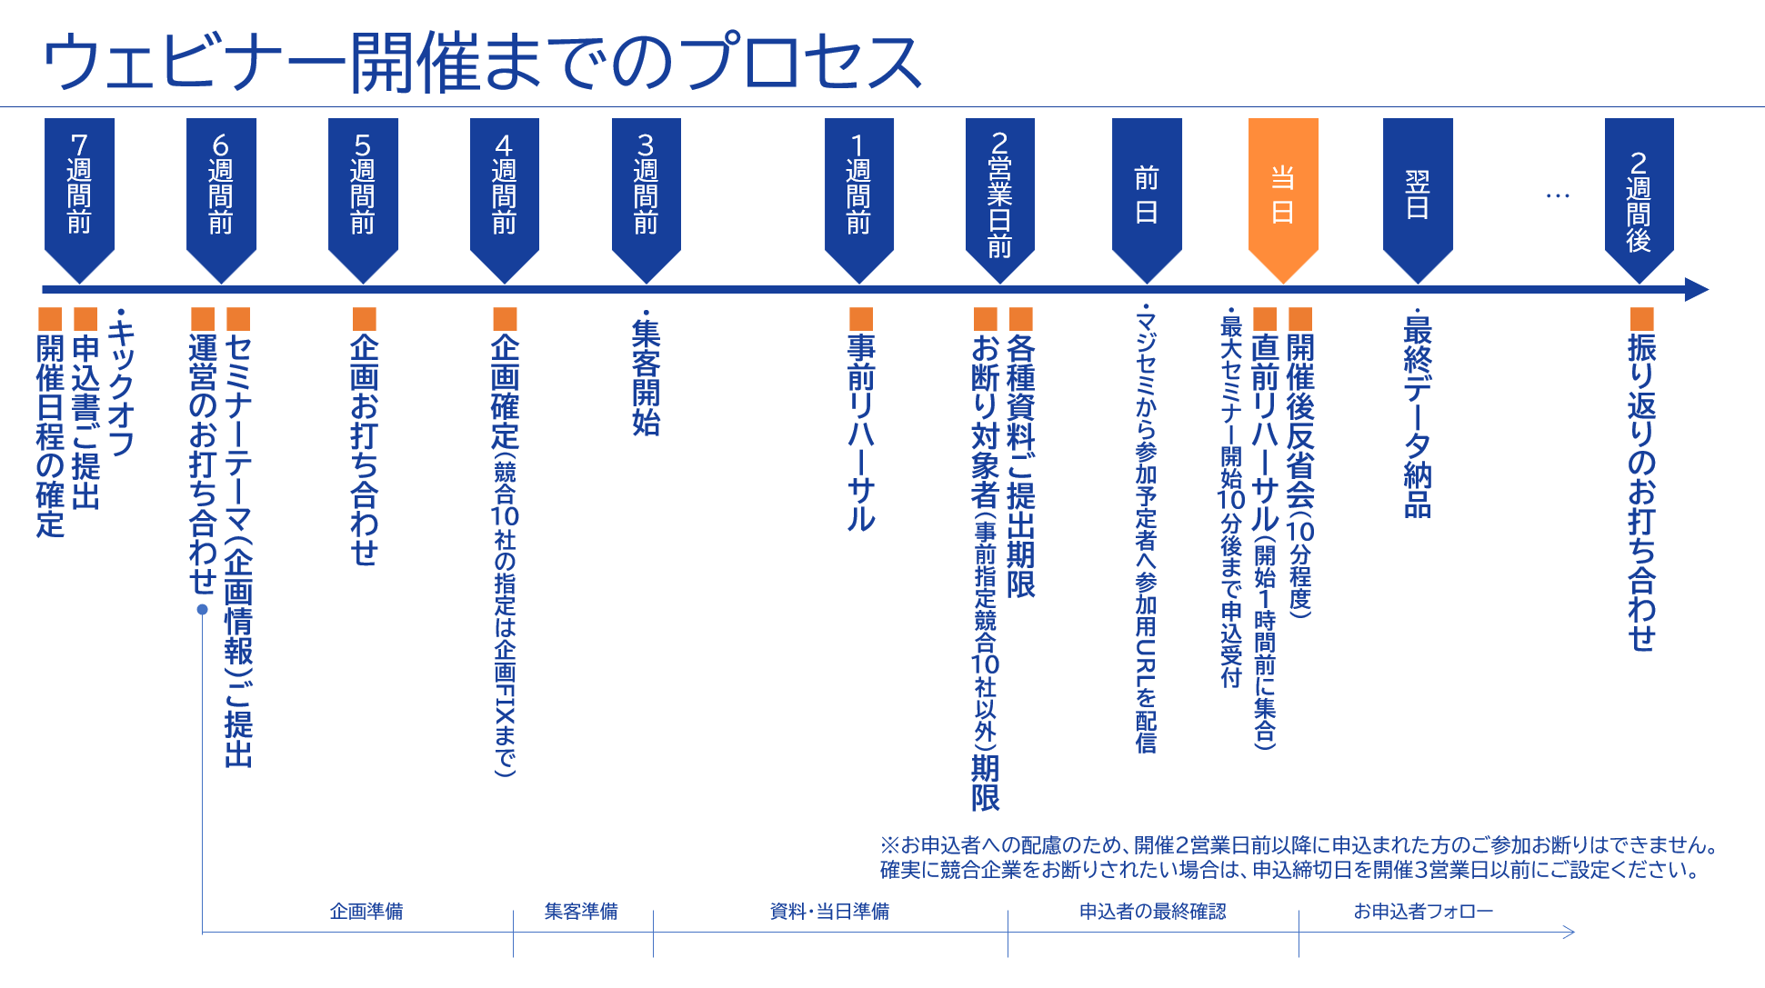
©2018 MAJISEMI Inc.

Slide 31
Take this opportunity to start with Majisemi!
Clients using Majisemi have shared feedback such as
The audience turnout is good,
and it leads to business negotiations.
Awareness has increased, and inquiries from the web
have also increased.
The staff (attendants and cast) were excellent,
making it easier to host seminars.
We have received comments like these.
And most client companies repeatedly host seminars with Majisemi.
However, you might have the following concerns.
"Will the target companies really attend?"
"How much easier will the operation become?"
For such customers,
we offer the 'Majisemi Club Membership First 20 Participants Free' campaign.
Please try Majisemi!
©2018 MAJISEMI Inc.

Slide 32
~Please check later~
(For your reference) Other information

Slide 33


Reasons to use Majisemi
Webinar
as a Service
Delegate your webinar operations to us
A dedicated planning manager will create the title and announcement text!
Planning
A Majisemi planning specialist with IT knowledge will collaborate with you to create a webinar plan that achieves audience acquisition and business negotiations.
STEP1
STEP2
STEP3
Final application
You will enter the product name, product information, target, and pain points into the management system.
Planning meeting
A one-hour meeting will be held online.
Details will be adjusted based on prior information.
Plan finalized
Press the approval button in the management system to finalize the plan.
At our company
Attraction page
Preparation for publication
Starts!!
By email
Confirmation
Attendants (seminar secretariat) will support you until the webinar is hosted!
Attendant
(Seminar administration)
An attendant with experience in operating 1,000 seminars annually will accompany you up to the seminar.
Feel free to consult us about any issues!
STEP4
STEP 5
STEP6
On the day
・Moderation
・Collect surveys
Launch of the event page
Create registration page
Handle registrants
・Respond to inquiri es ・Send reminders
・Issue participant URLs
Rehearsal
・Confirm schedule and requests for th e day ・Check speaker’s connection env ironment ・Confirm preparation status
Report creation
Cast
Cast
©2018 MAJISEMI Inc.

Slide 34
Reasons to use Majisemi
Webinar
as a Service
Dedicated support from the planning stage
Planning stage flow
Preliminary preparation
The planning officer will gather information on the seminar theme shared in advance and create proposals for promotional points.
Planning meeting
Hold a meeting for about one hour. We will propose promotional points and refine details.
Create proposal
Based on the details discussed in the meeting, the planning officer will draft titles and notification texts.
Submit proposal
After creating the proposal, the planning officer will email it to you.
Confirm proposal content
Please review the proposal content and provide feedback if necessary.
Finalize proposal
Once you review the content and the feedback revisions are complete, press the approval button in the management system to finalize the proposal.
Attraction page
Preparation for publication begins
©2018 MAJISEMI Inc.

Slide 35
Flow of the event
On the day of the event
Webinar
as a Service
Event time
Distribution tools
General flow of the seminar
You can choose from 5 time slots
(Weekdays only *No events on weekends and holidays)
The basic duration for one seminar is 1 hour
You can choose from 2 types
*We recommend Zoom for its functionality and delivery quality
*For seminars hosted by Majisemi, an additional fee is charged for events longer than 1 hour (150,000 yen/hour)
10:00-11:00
Registration starts
15 minutes
11:00-12:00
Opening
(Majisemi Cast)
Zoom
Teams
13:00-14:00
5 minutes
Presentation
14:00-15:00
30-40 minutes
Poll
3:00 PM - 4:00 PM
Q&A
(Navigated by Majisemi Cast)
* On Mondays, only the 2:00 PM and 3:00 PM sessions are available
* Majifolo is only conducted at the 10:00 AM and 11:00 AM sessions
*For seminars targeting the manufacturing industry, to avoid theme overlap, they are scheduled at 11:00 AM and 1:00 PM
10-15 minutes
End
©2018 MAJISEMI Inc.

Slide 36
Reasons to use Majisemi
Webinar
as a Service
Effective use of content
Branding & new lead acquisition
Create articles from presentation content
Register on your own site, also for SEO measures
SEO article
Create (blog)
During webinar hosting
Reuse content to
Continue lead nurturin g and acquire new lea ds even after hosting
Distributed later exclusively to absentees
Rebroadcast past Majisemi event videos
Effortless event without on-the-day presentation
Webinar Hosting
Missed session streaming
Rebroadcast
Recorded video
Uploaded to your own website or YouTube
Summary vid eo creation
On your own website or
Post on your company-managed social media
Webinars or videos not hosted by Majisemi
Secondary use on portals and advertising media
Full vide o provided/free*
Full video p rovided/secondary use*
Lead nurturing
Listed on majisemi.com
Acquire new leads
Majisemi Club Benefits
※In the trial, we do not provide full videos regardless of free or paid. However , after the main contract, past sessions can be provided regardless of the plan.
Maji Lead
Document download
©2018 MAJISEMI Inc.

Slide 37
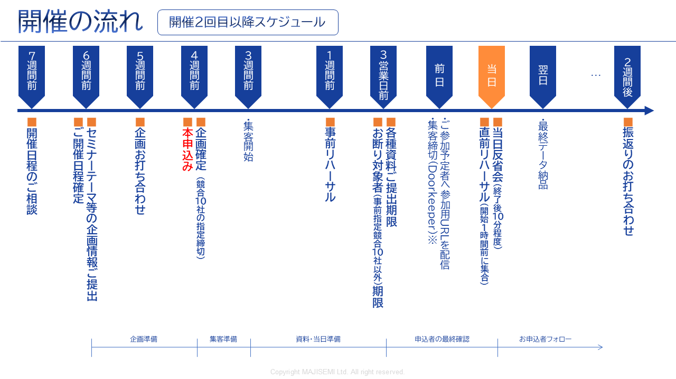
Webinar
as a Service
※To accommodate applicants, we cannot decline participation for those who apply within 2 business days before the event.
If you want to ensure competitors are excluded, set the application deadline 3 business days prior.
©2018-2024 MAJISEMI Inc.
©2018 MAJISEMI Inc.

Slide 38
Basic Plan
Majisemi Visitor
Plan details
Reference plan
Pricing Plans
This is a plan for holding one-time webinars on a fully performance-based fee.
You can choose from four types of delegation levels.
Accepted from applications of 20 people or more.
If there are only 10 applicants, you will only be billed for those 10 people.
14,500 yen per application (excluding tax)
・On-demand events, on-demand applications
・Performance-based billing based on number of attendees
・Applications from 20 people or more
(Billing is only for the number of attendees)
*To accurately track the number of attendees, we will prepare the application page and provide the list to your company.
*Billing will be based on the number of registrants up to the maximum specified above. Once capacity is reached, registration will be stopped.
*Due to privacy protection considerations, the list will be delivered directly to the seminar organizer.
*In addition to participants, absentees (pre-cancellation, day-of cancellation) will also be billed.
*While efforts will be made to achieve maximum capacity, attendance numbers are not guaranteed.
*There are cases where no attendees may be drawn due to the seminar theme or concurrent events.
Managing
Managing
Menu |  | Planning | Attracting attendees LP setup | Moderator | Other media Capture | URL delivery Reminder | Zoom Provision | Post-event Survey
Majisemi Visitor | Standard | ○ | ○ | ○ | No other media posting | ○ | ○ | ○
 | Planning and attracting | ○ | ○ | - |  | - | - | -
 | Attracting and managing | - | ○ | ○ | - | ○ | ○ | ○
 | Attracting only | - | ○ | - | - | - | - | -
Product name | Details | Quantity | Unit price (¥) | Amount (¥)
Majisemi Visitor (20 people) | Webinar Planning, attracting, and managing | 20 | 14,500 | 290,000
Visitor plan Reference plan for 20 people |  | Subtotal |  | 290,000
 |  | Consumption tax (10%) |  | 29,000
 |  | Total (inc. tax) |  | 319,000
©2018 MAJISEMI Inc.

Slide 39
Basic Plan
Majisemi Club Light
Plan details
Reference plan
Pricing Plans
Monthly fee ¥120,000 (excl. tax) *Light plan includes slots for 10 people.
Additional slots @¥10,000 (excl. tax)
Automatic renewal every month
Add slots for 10 people every month.
Minimum attendance for webinar is 30 people.
If hosting a webinar for 30 people in the first month, purchase additional slots for 20 people (@¥10,000).
If the number of attendees does not meet the capacity, the unmet attendance slots will be carried over to the following months.
Additional attendance slots can be purchased at @10,000 JPY.
If a person who has attended one or more of your last three paid seminars registers again for the current seminar, that seminar will not be subject to a charge (fan cultivation).
Additional perks include providing leads from those who downloaded publicly available presentation materials, the branding dashboard, and a trend analysis tool.
Majisemi Club is a membership service to improve webinars through PDCA in repeated webinars. Admission is subject to approval.
For Majisemi Club, we offer a one-stop service for planning, attracting, hosting, and managing. We do not support attracting only.
Also, the seminar content (planning) should be "problem-solving type seminar" instead of "product presentation." Product presentations should be conducted in the latter half of the presentation. The seminar content will be decided in consultation with the Majisemi planning members. We may not be able to hold it on the theme your company wants. If you want to decide the theme yourself, please use the visitor option.
In consideration of the purpose of Majisemi Club, if you cancel within one year of contract start, a penalty will be imposed. Please note. (You will be charged the difference with the visitor fee.)
*To accurately track the number of attendees, we will prepare the application page and provide the list to your company.
* If the capacity is reached, applications will be stopped.
*Due to privacy protection considerations, the list will be delivered directly to the seminar organizer.
* Count includes both participants and absentees (cancellations before or on the day).
* Contract automatically renews monthly and continues on the same terms.
* No refunds for unused slots upon withdrawal. Re-enrollment in Majisemi Club is prohibited for 1 year after withdrawal.
* For withdrawal, please notify by email by the end of the month prior to the withdrawal month.
* Benefits may change.
If you have challenges converting seminars into business discussions or want to strengthen your website content and SEO, we recommend the value set plan described below.
Product name | Details | Category | Amount (¥)
Majisemi Club Light (30 participants) | Planning, attracting attendees, and managing webinars | Monthly fee | 120,000
Majisemi Club Light Plan Attracting 30 attendees, For 10 attendees through monthly membership and 20 attendees through additional efforts |  | Additional participant slots | 200,000
 |  | Consumption tax (10%) | 32,000
 |  | Total (inc. tax) | 352,000
©2018 MAJISEMI Inc.

Slide 40
Basic Plan
Majisemi Club Light
billing pattern
Pricing Plans
Example of webinar hosting and billing with Majisemi Club
Add 10 attendance slots each month
Webinar
Held
Webinar
Held
Webinar
Held
seminars can be held anytime (or not at all)
(Target capacity is 30 or more attendees, with rebroadcast for 10 or more attendees)
Webinar
Held
 | January | February | March | April | May | June | July | August | September | October | November
Additional attendance slots | +10 | +10 | +10 | +10 | +10 | +10 | +10 | +10 | +10 | +10 | +10
Beginning of the month Remaining Attendance Slots | 10 | 10 | 20 | 30 | 15 | 10 | 20 | 30 | 40 | 50 | 10
Monthly fee billing | 120,000 yen | 120,000 yen | 120,000 yen | 120,000 yen | 120,000 yen | 120,000 yen | 120,000 yen | 120,000 yen | 120,000 yen | 120,000 yen | 120,000 yen
Seminar hosting Target capacity | 30 participants |  |  | 30 participants | 50 participants |  |  |  |  | 50 participants
Seminar hosting Event attendance performance | 30 participants |  |  | 25 participants | 48 participants |  |  |  |  | 50 participants
Consumption of attendance slots | -10 |  |  | -25 | -15 |  |  |  |  | -50
End of the month Remaining Attendance Slots | 0 | 10 | 20 | 5 | 0 | 10 | 20 | 30 | 40 | 0 | 10
Additional participant slots | 20 |  |  |  | 33
Additional participant slots billing | 200,000 JPY |  |  |  | 330,000 JPY
Target capacity is 30 or more attendees
It's OK to hold events for 50, 100, etc.
It's OK even for a seminar with 30 attendees from the first month
carry over any shortfall to the next month
Any shortfall will be billed at @10,000 JPY.
There will be no more attendees than the target capacity.
©2018 MAJISEMI Inc.

Slide 41

Basic Plan
Majisemi Club Business Negotiation Guarantee
Plan details
Reference plan
Pricing Plans
600,000 JPY every 3 months (tax excluded)
Contract auto-renews every 3 months
Guaranteed 30 attendees and 3 business discussions every 3 months
Included Majifolo for free
If unmet, the shortfall will be carried over to future seminars
For additional hosting of 31 or more people, registration per person is 13,500 yen
If a person who has attended one or more of your last three paid seminars registers again for the current seminar, that seminar will not be subject to a charge (fan cultivation).
Additional perks include providing leads from those who downloaded publicly available presentation materials, the branding dashboard, and a trend analysis tool.
This is a plan that automatically renews every 3 months. It guarantees 30 attendees and 3 business discussions (appointments).
We will handle everything from planning seminar content and attracting attendees to managing the event and sending materials to participants.
Majifolo is included in the fee.
If fewer than 30 attendees or 3 discussions are achieved in the initial seminar, it will be carried over to the current or next quarter,
We will host additional seminars accordingly. (The goal is to achieve this in the initial attempt.)
※ To accurately know the number of attendees, we will prepare the application page and provide the list to you.
※ Registration will stop once capacity is reached.
*Due to privacy protection considerations, the list will be delivered directly to the seminar organizer.
* Count includes both participants and absentees (cancellations before or on the day).
※ The contract automatically renews every three months and will continue to do so.
* No refunds for unused slots upon withdrawal. Re-enrollment in Majisemi Club is prohibited for 1 year after withdrawal.
※ Please inform us by email if you intend to withdraw by the end of the month before the withdrawal month.
※ We may not be able to accommodate the discussion assurance option.
* Benefits may change.
Product name | Details | Quantity | Unit price (¥) | Amount (¥)
Majisemi Club event (30 participants) | Planning, attracting attendees, and managing webinars | 1 | 600,000 | 600,000
Majifolo (30 participants) | Appointment setting via phone and email for participants | 30 | 3,500 | 105,000
 | All cases are free with the Majisemi Club meeting guarantee | 30 | -3,500 | -105,000
Majisemi Club meeting guarantee plan Reference plan for 30 participants |  | Subtotal |  | 600,000
 |  | Consumption tax (10%) |  | 60,000
 |  | Total (inc. tax) |  | 660,000
Guaranteed attendance and meetings!
©2018-2023 MAJISEMI Inc.

Slide 42
Cost-effective plan for Majisemi Club (update pending)
Pricing Plans
Recommended
 |  | Light | Silver | Gold | Platinum | Premium
Included services | Webinar hosting | ● | ● | ● | ● | ●
 | SEO article creation | ― | ●※1 | ― | ― | ●※1
 | MajiFollow | ― | ― | ●※2 | ●※2 | ●※2
 | MajiFollow Plus | ― | ― | ― | ●※3 | ●※3
 | Summary video | ― | ― | ― | ― | ●※1
Bonus slots for additional attendees (Special offer) ※4 |  | ― | 10 people each year 100,000 yen equivalent | 20 people each year 200,000 yen equivalent | 40 people each year 400,000 yen equivalent | 80 people each year 800,000 yen equivalent
Monthly fee |  | 120,000 yen | 135,000 yen | 155,000 yen | 255,000 yen | 385,000 yen
Simple webinars
Just want to request hosting
Want to use the lecture content
On the website too
Want to follow up
Immediately after the webinar
ウェビナーから確実に
商談につなげたい
ウェビナーの効果を
最大化したい
※1 SEO article creation and summary video creation can be conducted up to four times a year. Additional instances can be purchased as an option.
※2 MajiFollow can be conducted for up to 120 people per year. Additional instances can be purchased as an option.
※3 Includes the monthly activity cost for MajiFollow Plus. A success fee (30,000 yen per appointment) will be incurred separately.
※4 The bonus slots for additional attendees will be granted one year after joining Majisemi Club and will be granted in the same month each year thereafter.
(All amounts are tax exclusive)
©2018 MAJISEMI Inc.

Slide 43
その他のオプション ※詳細は個別にご相談ください
Webinar
as a Service
Name | Price (excluding tax) | Details
MajiFollow (Post-seminar follow-up) | @3,500円×集客人数 | マジセミのフォロー専門スタッフが、セミナー終了直後に参加者、欠席者に対して、メール、電話でフォローします。
SEO article creation | 5万円 | セミナーの講演内容から、SEOを意識した3,000字程度の記事を作成します。貴社のWebサイトに掲載することで、コンテンツマーケティングを促進します。
Full video provision/paid | 200,000 JPY | セミナー動画をご提供させていただき、２次利用していただくためのオプションです。 ※一定の利用制限内であれば無料でご提供いたします。トライアル時は、有料、無料ともご提供はありません。
Summary video creation | 5万円 | セミナー動画をYoutube等に掲載する場合、長時間の動画は嫌われる傾向があります。このため5～10分程度に編集してご提供いたします。
Missed session streaming | 5万円 | セミナー申込者の内、当日欠席された方に対して、当日の動画を視聴していただきます。
Rebroadcast | @14,500円/10,000円 | 過去マジセミで開催した録画を使って、手間なく追加のウェビナーを開催します。
Two-step webinar | ２０万円 | 過去に貴社のウェビナーにお申し込みいただいた方（貴社の見込み客）に対して、より商談（アポ）につながるテーマ（他社比較、製品紹介、デモなど）を企画し、開催します。
Operational support (operation outsourcing) | ２０万円 | 貴社セミナーの運営を代行します。申込みページの作成、申込者の管理、Zoomの貸出、当日の司会進行、など一連の作業を代行します。（集客は含まれません。貴社にて集客していただきます。）
マジセミ代表 寺田による Presentation at your seminar | 30万円～ ※30分～1時間程度 | マジセミ代表 寺田が、貴社セミナーでのプレゼンや対談、パネルディスカッションのファシリテーターを行います。テーマはご相談ください。
“エバンジェリストAI”デジタル寺田による基調講演代行 | 10万円 | 生成AIを活用した“エバンジェリストAI”デジタル寺田が、貴社のウェビナーで基調講演を行います。 - Want to give a seminar presentation but don't have time to create the script and slides - No skilled presenters among employees (or they are too busy), so want to outsource the presentation as well
SEO video creation | 1本5万円～ ※10本単位、初期費用別 | Youtubeの検索や、Googleの動画検索で上位表示を狙うための施策です。マジセミが貴社専用のAIアバターを作成、用語解説の動画コンテンツを作成します。原稿も納品、ブログ活用も可能です。
Product comparison video creation | 50万円～ ※初期費用別 | 貴社の製品の強みを強力に認知させるための競合製品比較動画を作成します。マジセミが貴社専用のAIアバターを作成、製品比較動画コンテンツを作成します。ウェビナーでの配信も可能です。
©2018 MAJISEMI Inc.

Slide 44
Notes
Webinar
as a Service
■ Typically, we start discussions 6 weeks in advance, aiming to finalize applications 4 weeks before the event.
Additional charges
キャンセル料金
全てのサービスにおいて、マジカン（マジセミ管理画面）から「本申込」をしていただいた後、又は発注書・申込書を受領した後にキャンセルされた場合、100%のキャンセル料金が発生します。
但し、ウェビナー開催については、ビジターは20名分のキャンセル料金、マジセミ倶楽部においては30名分の集客枠の消費を上限とします。
マジフォロについては、ビジターの場合は20名分、マジセミ倶楽部の場合は30名分のキャンセル料金を上限とします。
ウェビナー開催において、タイトル、告知文などの調整が遅れて、ウェビナーの公開が開催日の１０営業日前の17時までに行えなかった場合、キャンセルの扱いとし上記キャンセル料金をご請求いたします。
マジセミ倶楽部の退会時、集客枠残について返金できません。
マジセミ倶楽部の主旨を鑑み、マジセミ倶楽部の契約開始から１年以内の解約の場合、ペナルティを設定させていただいております。ご了承ください。（ビジターの料金との差額をご請求いたします）
Majisemi Visitor
開催4週間前を過ぎての発注は、料金が割り増しになります。
 | Unit price (excluding tax) | 上限指定
Basic fee (Order placed 4 weeks before the event) | 14,500 yen | More than 20 people
Order placed after 4 weeks before the event | ×1.25 times surcharge
Order placed after 3 weeks before the event | ×2 times surcharge
Various Majisemi Club
If the application cannot be completed 4 weeks before the event, there are no additional charges, but the event will be postponed upon consultation.
©2018 MAJISEMI Inc.

Slide 45
Majisemi Corporation

Slide 46

Company name
Head office location
Representative
Business activities
Seminar hosting achievements
Established
Capital
Number of employees
Majisemi Corporation
3rd Floor, Shiodome Building, 1-2-20 Kaiga n, Minato-ku, Tokyo 105-0022 Yuichi Terada
Operation of the B2B seminar marketing service "Majisemi" specializing in IT and manufacturing industries
Last year's achievement: approximately 1,000 events held with a total attendance of about 60,000 people (2023)
January 2018
10 million yen
45 employees
About Us
Company overview
To create a platform for new encounters and experiences with digital products and services, thereby promoting the development of domestic industries and the advancement of engineers.
To achieve this, we aim to communicate superior technology and its potential widely to society, regardless of the size of the providing company.
To communicate clearly to end users not the technology itself, but how their problems can be solved by that technology.
By 2025, we aim to host 2,000 webinars annually.
MISSION
Transform seminars into entertainment
Change society through seminars
Thanks to you, we achieved three No.1
achieved! 1
No.1 in seminars strong in attracting customers
Seminars chosen by
IT managers
No.1
For acquiring new business negotiations
Seminars strong in
No.1
©2018 MAJISEMI Inc.
Survey overview by Japan Marketing Research Organization: 2021 service comparison impression survey

Slide 47
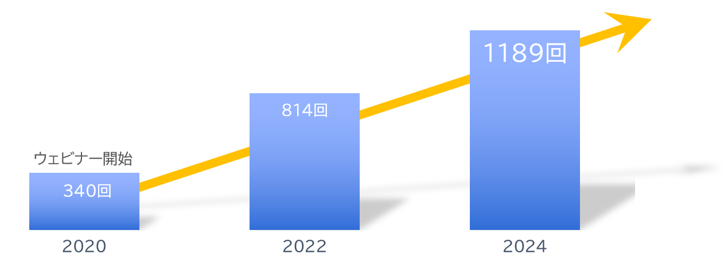
About Us
With partners and
The number of seminars hosted is
Increasing every year!
A10 Networks, Inc.
ITec Hankyu Hanshin Co., Ltd.
Advantech Co., Ltd.
AXIO Corporation
Assist Corporation
ITOCHU Techno-Solutions Corporation
Internet Initiative Japan Inc.
Infocom Corporation
Equinix Japan K.K.
SCSK Corporation
F-Secure Corporation
MOTEX Inc.
Encourage Technologies Co., Ltd.
Entrust Japan Co., Ltd.
OGIS-RI Co., Ltd.
OPRO Co., Ltd.
QlikTech Japan K.K.
Cross Head Co., Ltd.
KCCS Mobile Engineering Co., Ltd.
Serverworks Co., Ltd.
Sios Technology, Inc.
Cybertrust Japan Co., Ltd.
ZEAL Corporation
CTC System Management Corporation
Systena Corporation
Singapore Telecommunications Japan Co., Ltd.
GMO GlobalSign K.K.
JB Service Co., Ltd.
Startia Raise, Inc.
Smart Style Co., Ltd.
Sumitomo Electric Information Systems Co., Ltd.
Zoho Japan Corporation
Soliton Systems K.K.
Dynatrace
TIS Inc.
Techvan Co., Ltd.
TechMatrix Corporation
Delivery Consulting Inc.
Dell EMC
NSW Inc.
Hulinks Inc.
Netskope Japan Co., Ltd.
Pasona Tech, Inc.
Nippon Telegraph and Telephone East Corporation
Fujitsu Limited
Fujitsu Communication Services Limited
Fuji Electric IT Solutions Co., Ltd.
Mitsubishi Electric Information Systems Corporation
Mirantis Japan Corporation
Monstar Lab, Inc.
Red Team Technologies Inc.
Rosetta Corporation
(Agent)
MM Research Institute
Creative Bank Inc.
Target Media Co., Ltd.
Nikkei Advertising Inc.
Bigbeat Inc.
Mynavi Corporation
Transaction record
Major clients only, listed in alphabetical order
©2018 MAJISEMI Inc.

Slide 48
No.1 in seminars strong in attracting customers
No.1 for acquiring new business negotiations by seminars
No.1 seminar chosen by IT managers
Survey by Japan Marketing Research Organization Overview: 2021 Service Comparison Impression Survey
Transform seminars into entertainment
Change society through seminars

